Slide 1
Nervous system
Simple to complex
Jellyfish to a Human
Same: sensory- processing center- motor output-muscle (behavior)

Slide 2
Excite sensory: ?
Pass the information along to next cell ?
-Synapse (electrical or chemical)
Electrical- gap junctions (fast transmission, hard to tweak)
Chemical- receptors

Slide 6
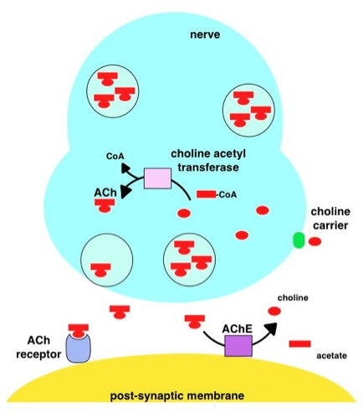
Modulation of synapses:
Feedback mechanisms
Autoreceptors
Repackaging of transmitter
Depression
Facilitation

Slide 7
Diseases : ?
http://neuromuscular.wustl.edu/synmg.html
Classes ?
http://meetings.cshl.edu/courses/2015/c-ion15.shtml

